Slide 1
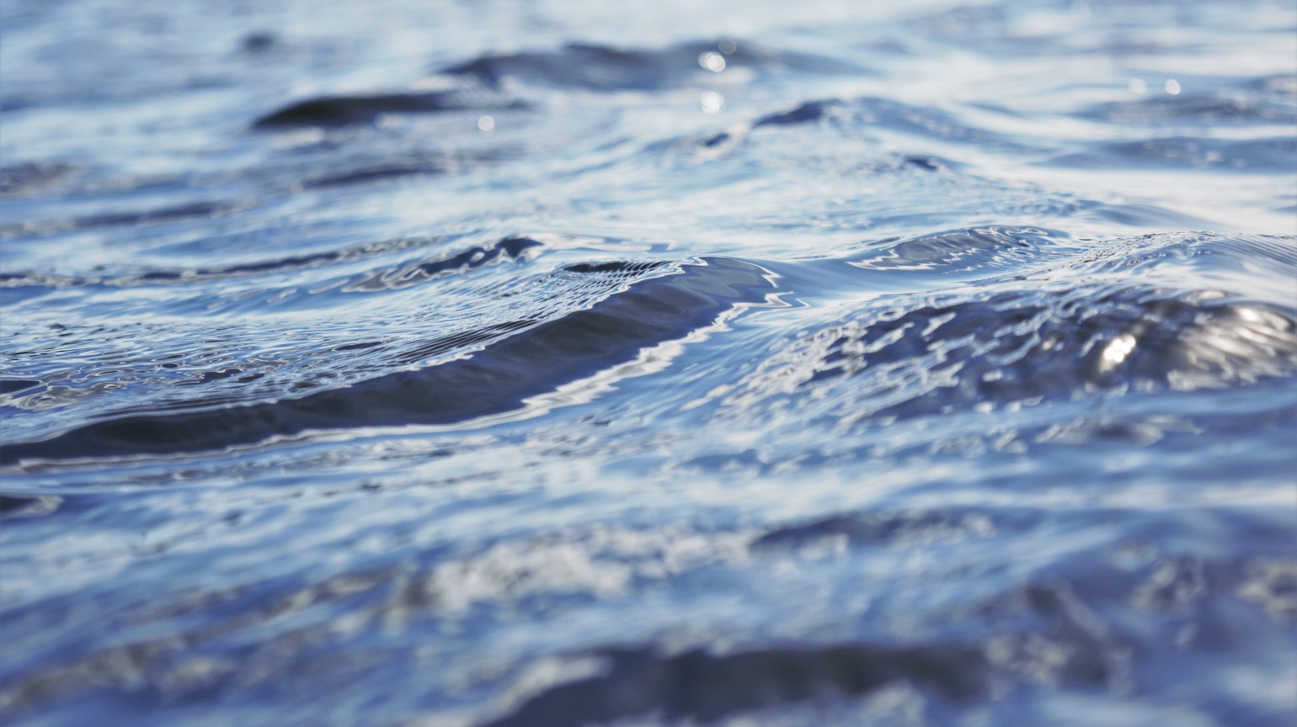

Adaptive Management of Barriers in European Rivers
A collaborative project for guidance on Barrier location removal and mitigation in Europe.
www.amber.international

Slide 2


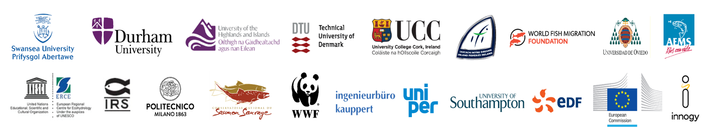
period June 2016 - May 2020
8 Universities
Swansea (UK),
Durham (UK),
Highlands & Islands (UK), Southampton (UK),
Cork (Ireland),
Oviedo (Spain),
Milan (Italy),
DTU (Denmark).
4 Industrial partners
Hydropower – EDF (France),
IBK (Germany)
Innogy (Germany), Sydkraft (Sweden)
4 NGOs
WFMF (Netherlands), WWF (Switzerland), CNSS (France),
AEMS (Spain)
4 Government organizations
IFI (Ireland),
ERCE (Poland),
SSIFI (Poland), Joint Research Centre (Italy)
IC: 11 MW
Notes:
Overview of who is involved in this project

Slide 3
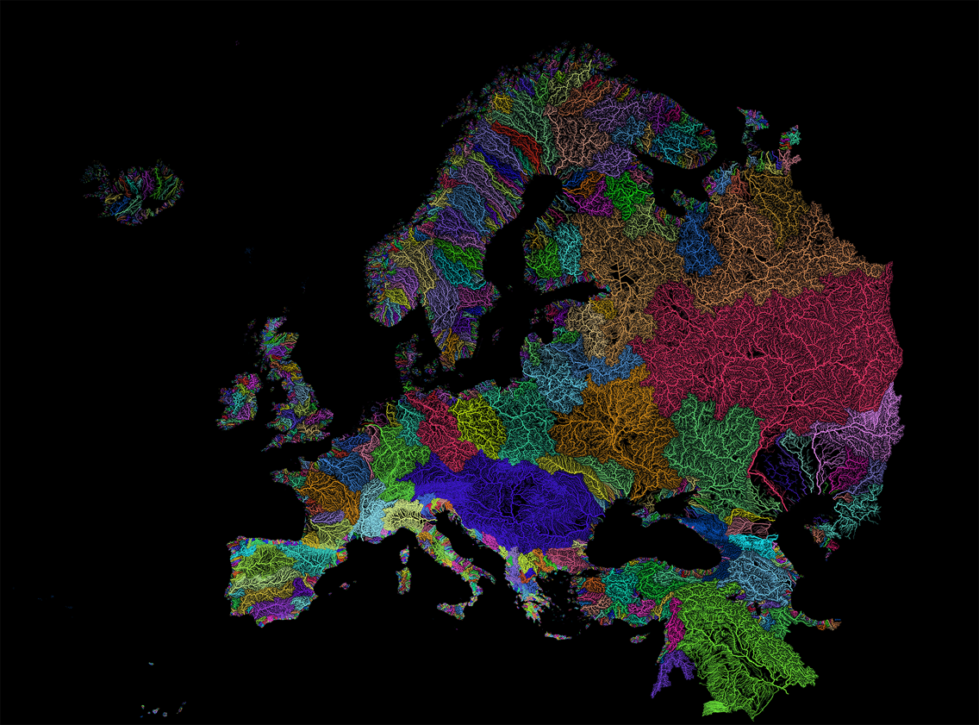
Rivers:
Veins of the earth
Notes:
We are all collaborating in this project because it is important to protect these veins of our earth. Here we can see just how prominent they are within our landscape and we depend so much on them for many of our resources—water, fish, recreational opportunities, birdlife, and so much more.

Slide 4
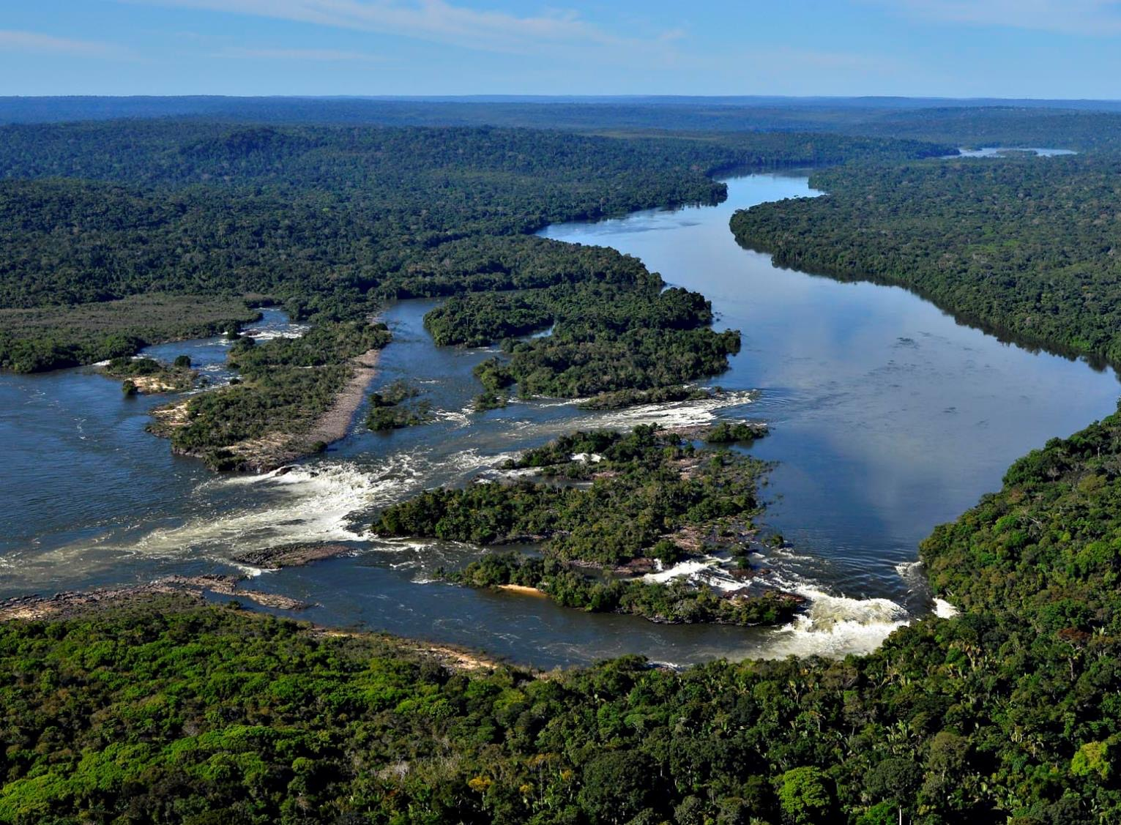

Free-flowing rivers…
biodiversity hotspots
Notes:
Tapajos river, São Simão Falls
Free-flowing rivers are the freshwater equivalent of wilderness areas; however remaining free-flowing rivers are considered even rarer than terrestrial wildernesses and pressures on remaining free-flowing rivers threaten to accelerate the decline of freshwater species in many river systems. Actually, freshwater species have experienced nearly twice the decline of terrestrial or marine species. However, no global registry of free-flowing rivers exists to underpin monitoring of their status over time and to help catalyze their protection, particularly through influencing the major infrastructure decisions that undermine their viability and ability to deliver ecosystem services.

Slide 5
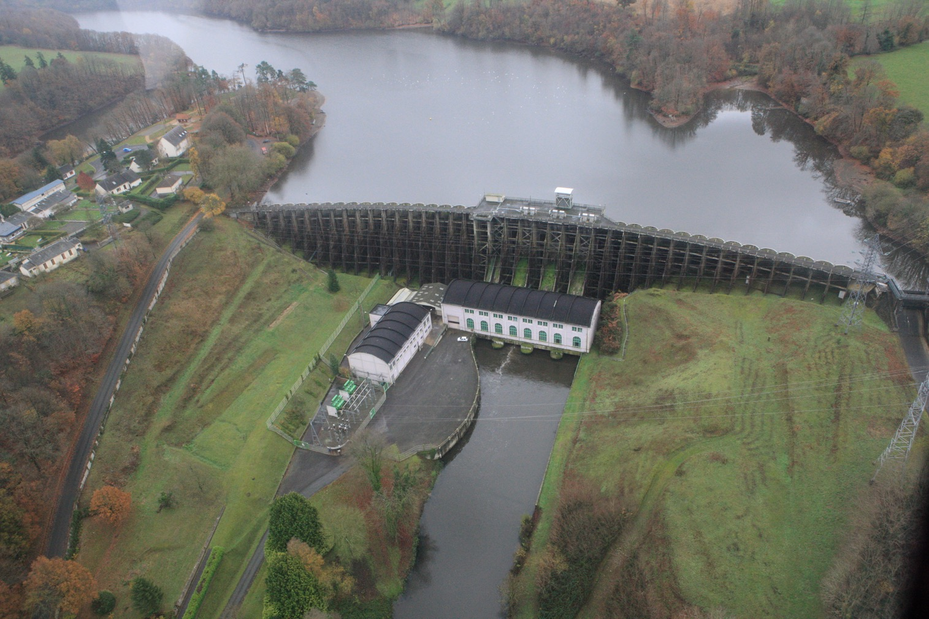
Types of Barriers
Dams, Weirs, Culverts, Sluices, Ramps,
Pumping Stations, Tide Gates, Fords, etc.
© European Rivers Network
Notes:
And some of the main obstructions for rivers are barriers like this large hydropower dam seen here. River barrier include dams, weirs, etc.

Slide 6
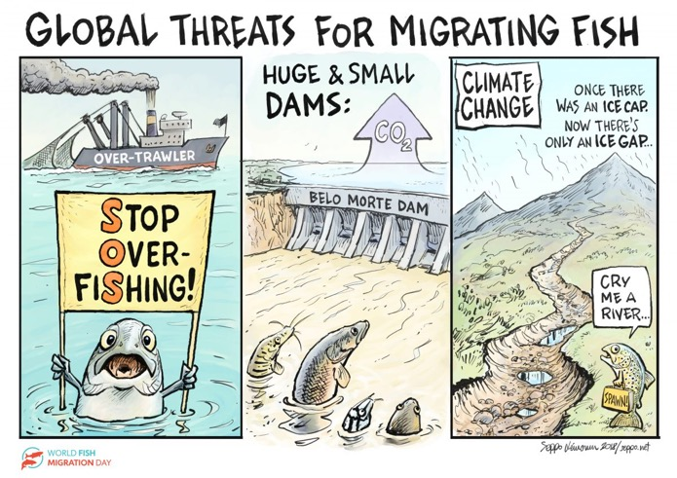
Fish biodiversity and their present conservation status
Threats to fish biodiversity:
Harvest
Habitat
Hatcheries
Hydro
Notes:
Why AMBER? It has been said that the main impacts that affect fish in freshwater ecosystems begin with H.
Overexploitation, Harvest
Habitat Loss
Hatcheries (and perhaps more specifically IAS)
And the last H, which is the subject of this presentations, is Barriers, Obstacles , Fragmentation-the interruption of river flow by human activity-
which more often than not, are caused by hydroelectric development.

Slide 7
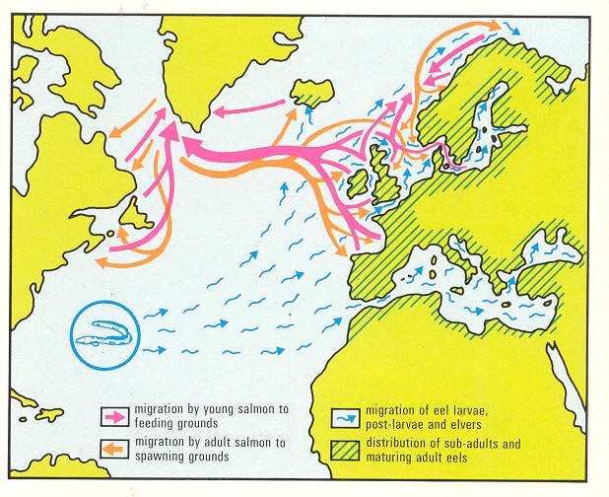
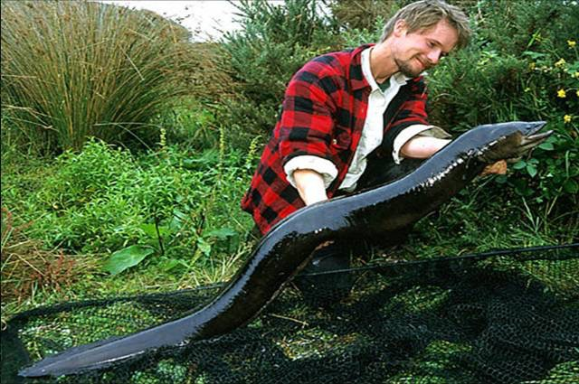
Making love
“We want to mate, ‘mate’”
© Jeroen Helmer
Notes:
Many fish species need and use rivers to complete their life cycles. They need these habitats to spawn and feed and when these barriers block their routes, populations decline

Slide 8
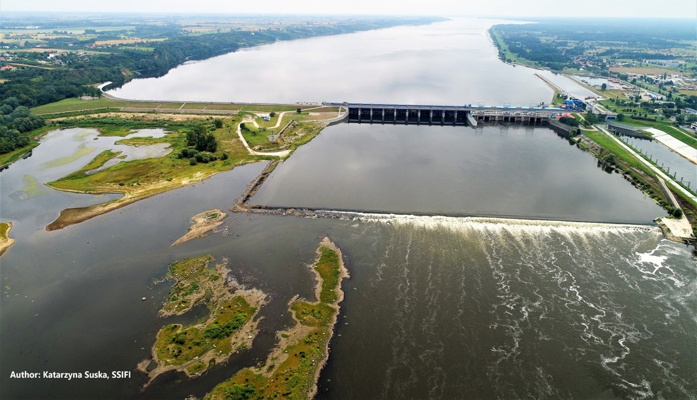
Loss of accessibility for migratory fish due to dams in major European river basins
Thousands planned or under construction (even in Europe)
Globally, Europe is the continent with the smallest number of completely unfragmented Large River Systems - just three rivers in northwestern Russia
(Nilsson et al. 2005).
Dams are among the most widespread alterations on aquatic ecosystems, 60% of the world's major rivers being impounded for human use
(Nilsson et al. 2005).
Notes:
Barrier act as roadblocks to the flow of water and the migration of fish species. And what is even more unfortunate is that there are thousands of these barriers not only big ones like we see here but even smaller ones! However, not all of these barrier are useful, some are old and obsolete but often left and neglected for years.

Slide 9
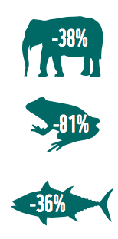
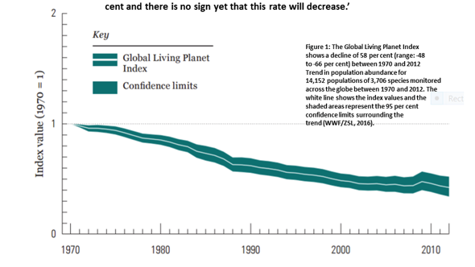
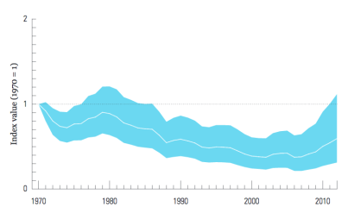
Fish biodiversity and their present conservation status
Global LPI 2016
Migratory Fish LPI 2016
-58%
-41%
!!!
(Source: Living Planet Report 2016, WWF)
Notes:
And if we neglect to clean up our rivers of the old and obsolete barriers or restore and repair ones in good standing, the health of our rivers and their ecosystems will deteriorate like we have already seen.
According to the latest Global LPI, published by WWF in 2016, in the last 42 years 58% of the vertebrate species show a decline in their populations. This index measures the state of biodiversity from1970 to 2012 based on population trends of vertebrate species from around the world.
In particular, in freshwater systems (rivers, deltas, wetlands etc…) the amount of species has dropped the terribly amazing amount of 81 %, an average loss much greater than that of land and marine species.
If we go to migratory fish species , this number is slightly smaller, it goes down to 41% decline in migratory fish species between 1970 and 2012.

Slide 10

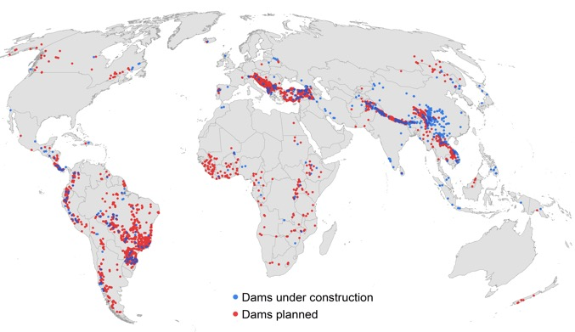
Loss of accessibility for migratory fish due to barriers in major European river basins
Much of Europe’s drinking water , irrigation or flood control relies on dams
Hydropower supplies 80% of the electricity generated from renewable sources in Europe and 10% of total electricity consumption
Expected boom in hydropower
Zarfl et al. 2014
Notes:
But the other reality is that dams provide us essential services and therefore cannot simply be removed. Chances are that much of the water you drink, the electricity you use or the food you eat would not be possible without dams.
Even more, without opening the discussion of weather it is correct or not, the fact is that hydropower is considered to be a clean and renewable energy, and it is key to achieve the EU’s 20% renewable energy target for 2020 according to the Renewable Energy Directive. In fact, in some European countries minihidraulics are expected to increase up to 40% to achieve this target.
And this trend is not only in Europe, we expect a worldwide hydropower boom . This maps shows the distribution of future hydropower projects. In blue, dams under construction, in red dams planned.

Slide 11
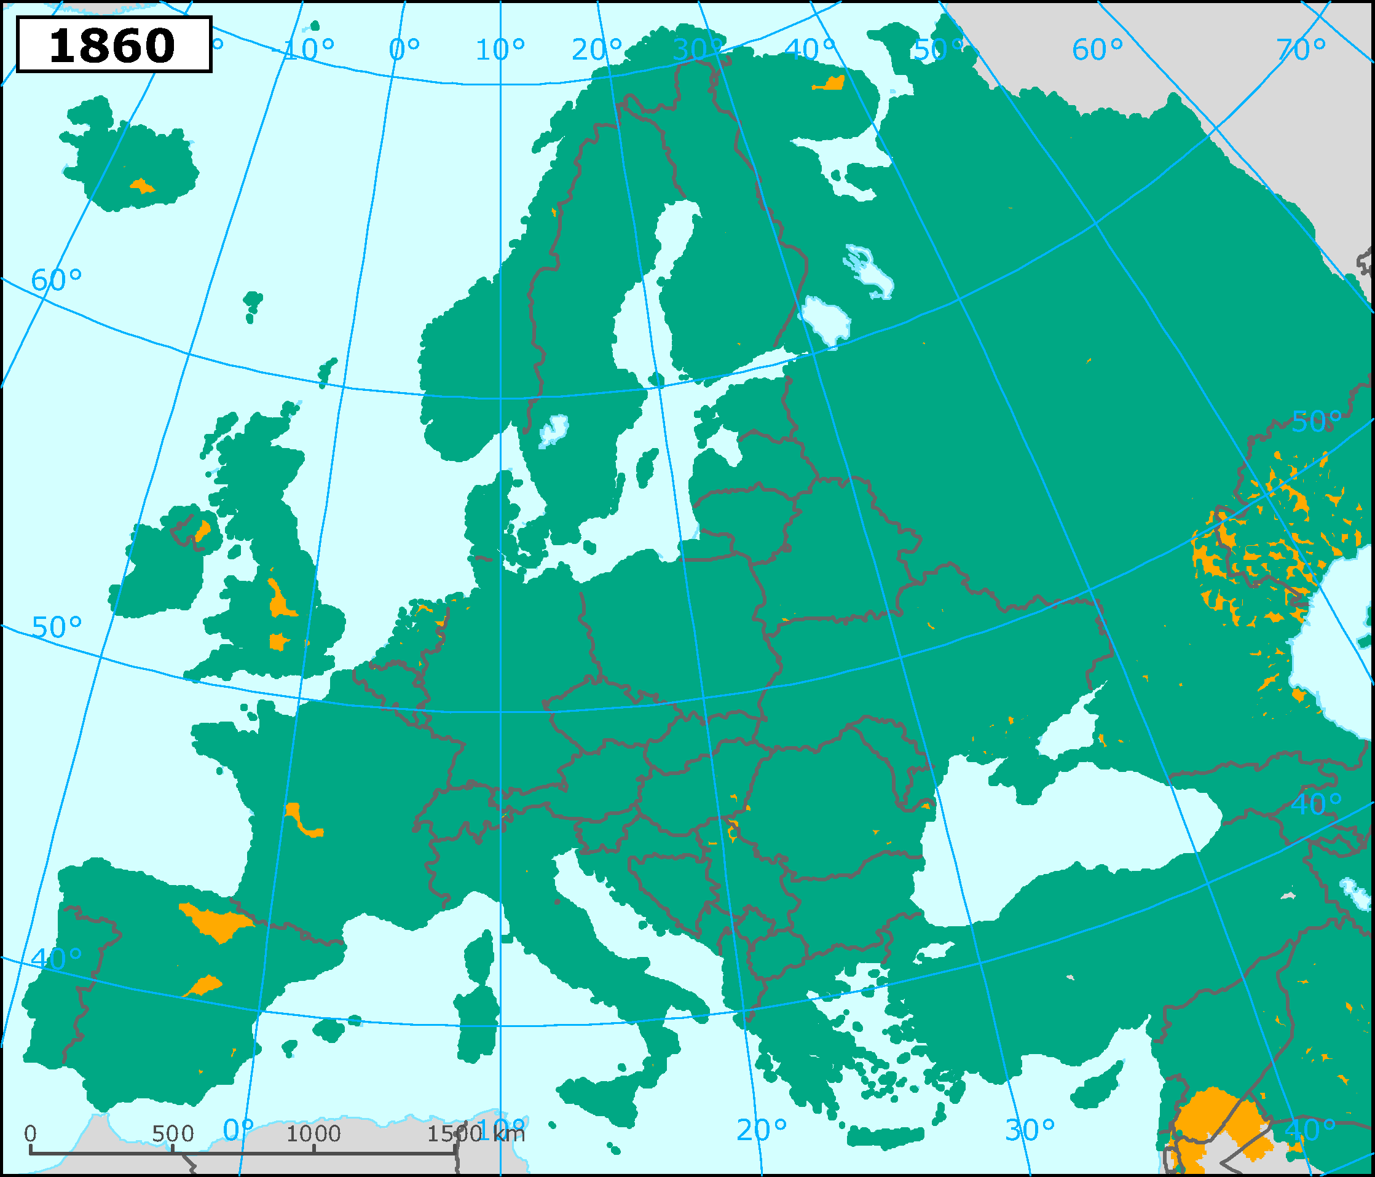
Barriers > 10 m
Maps from European Environment Agency
Notes:
Over time we have considerably fragmented our rivers…1860

Slide 12
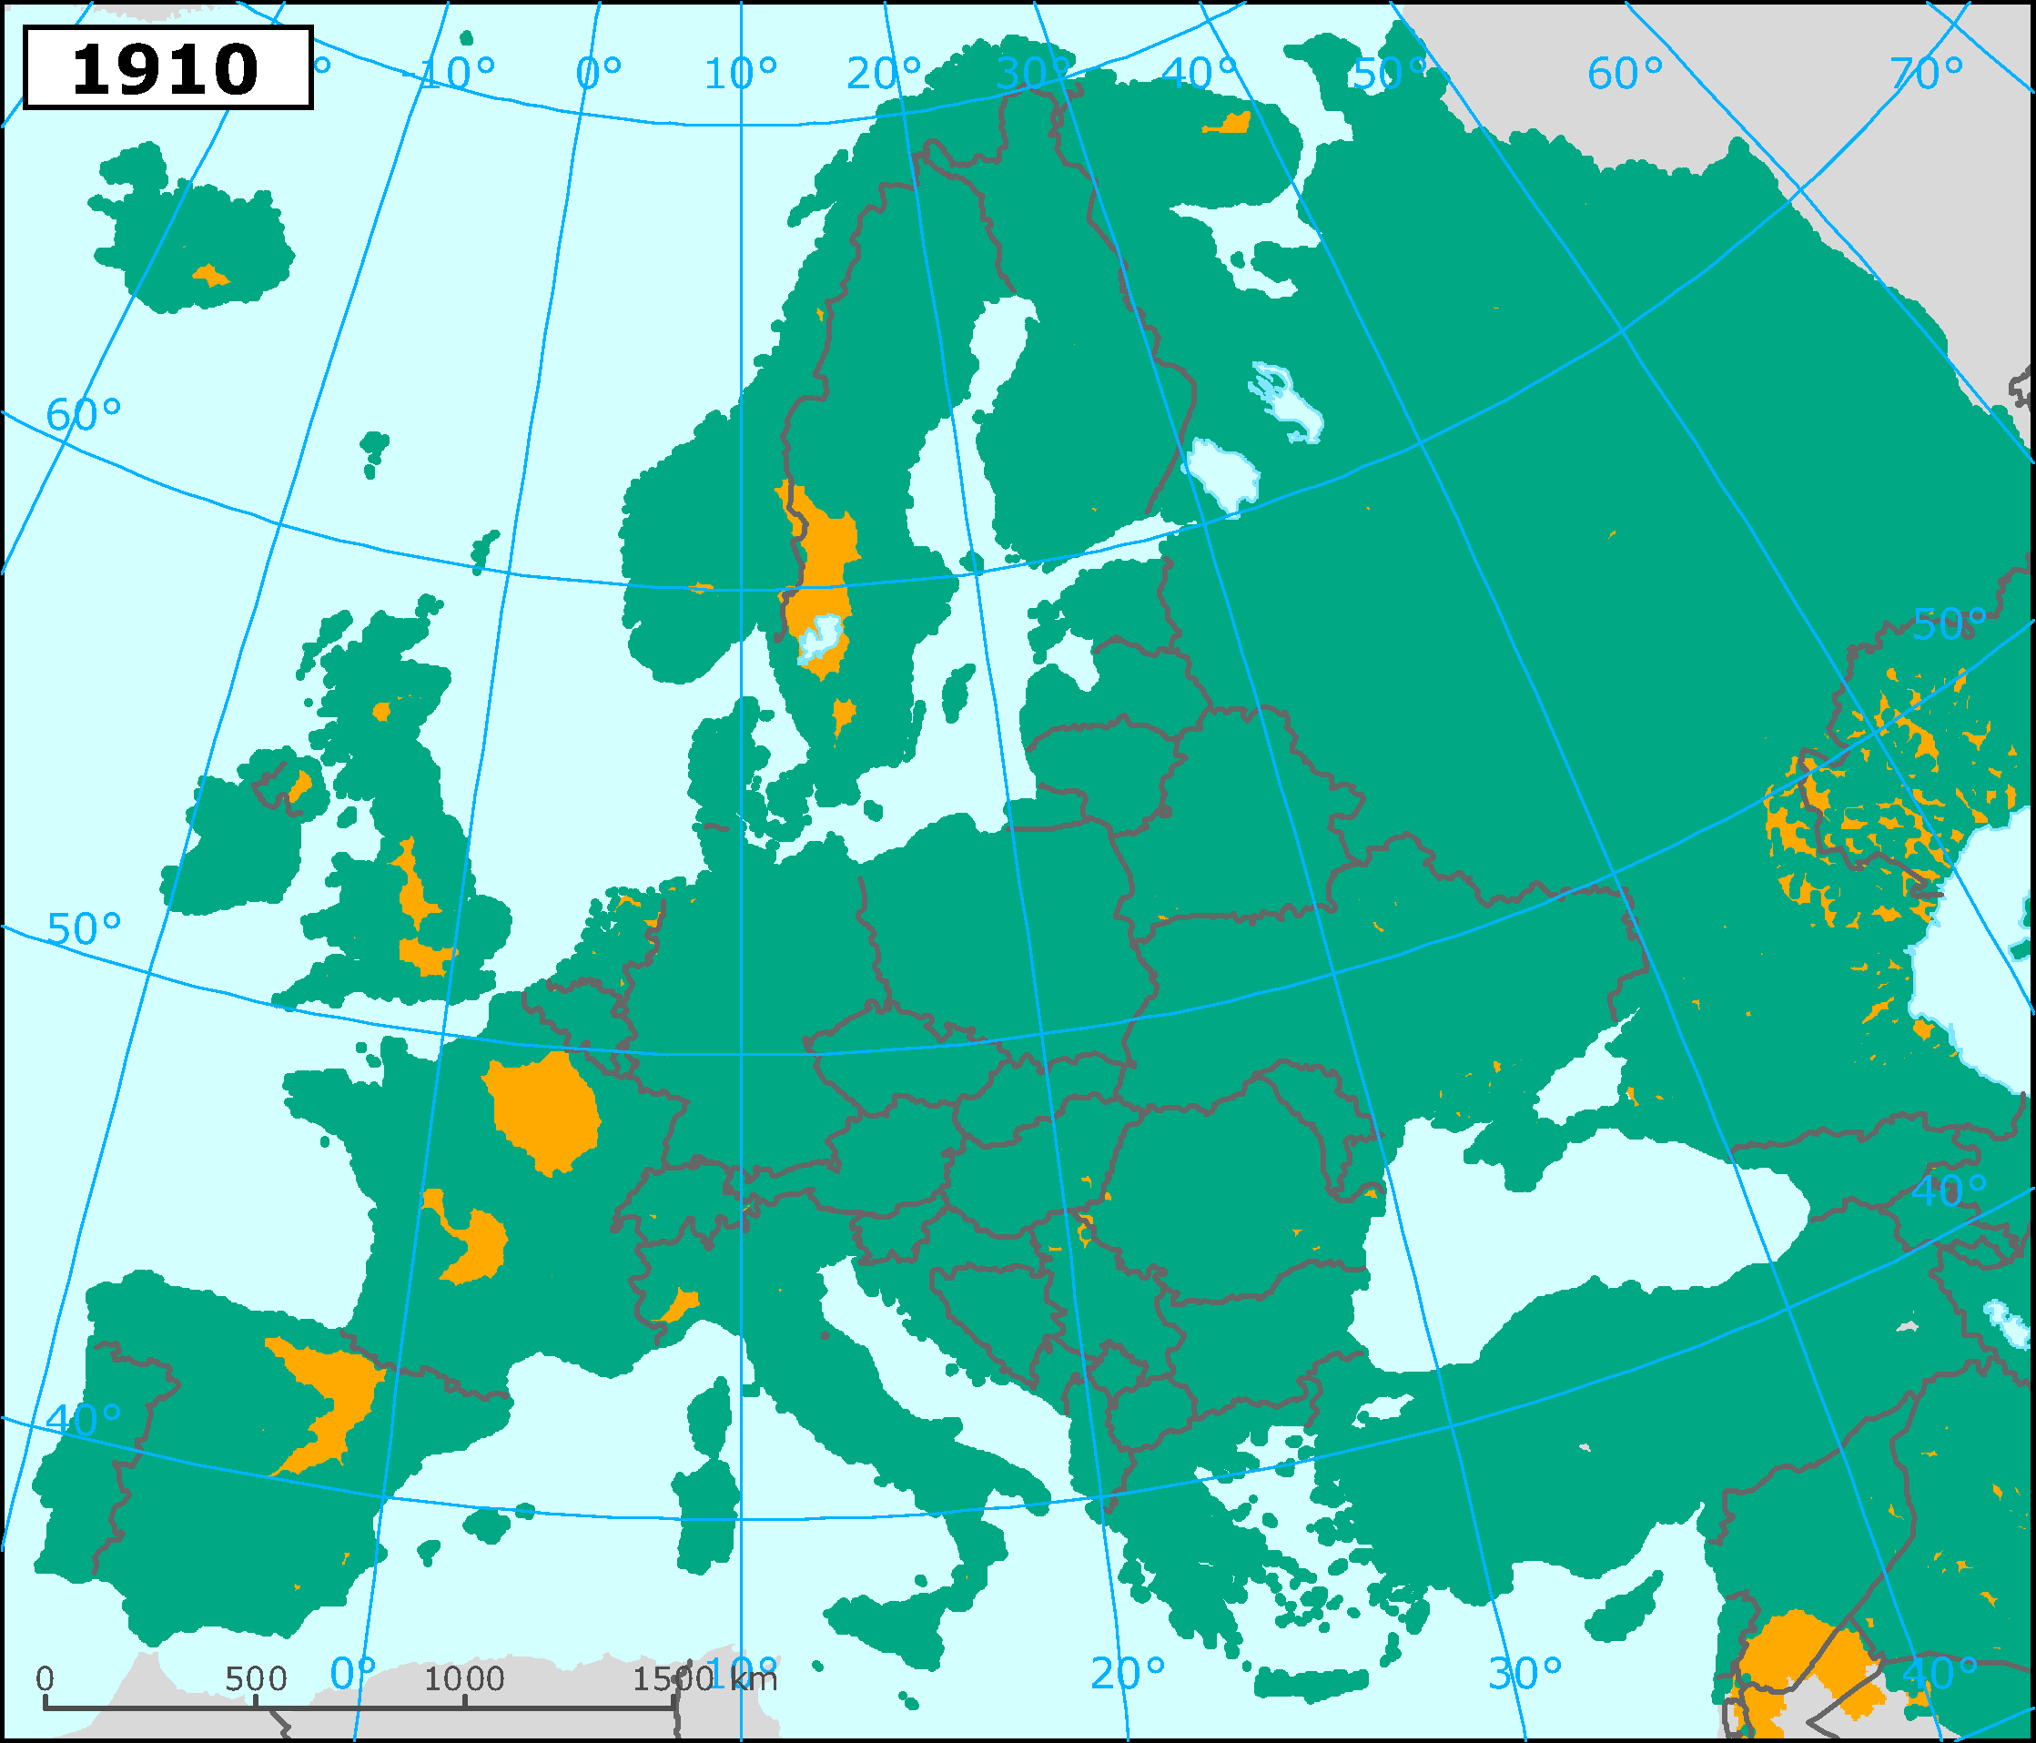
Barriers > 10 m
Maps from European Environment Agency
Notes:
Over time we have considerably fragmented our rivers…1860

Slide 13
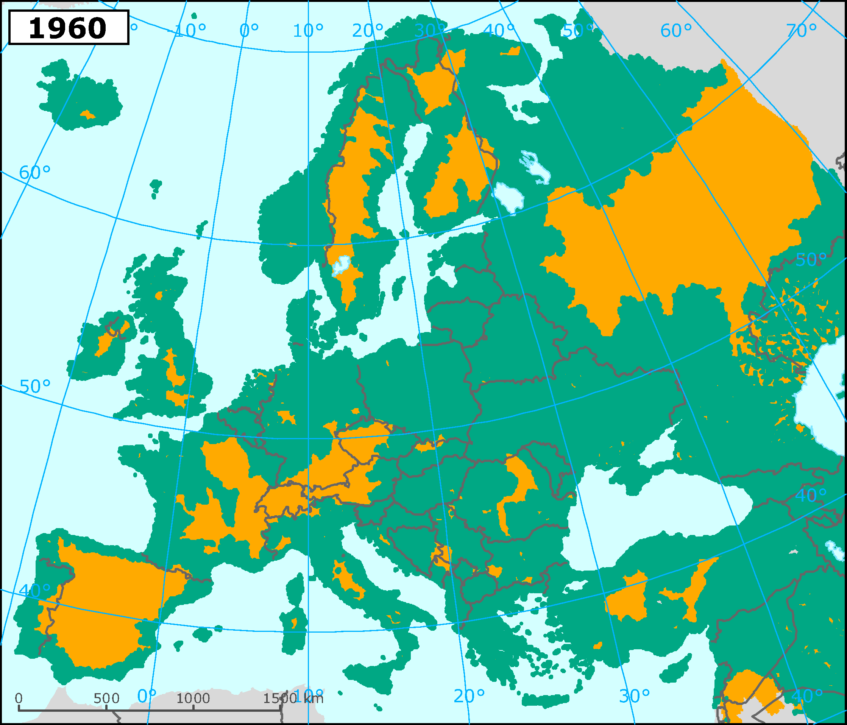
Barriers > 10 m
Maps from European Environment Agency
Notes:
Over time we have considerably fragmented our rivers…1860

Slide 14
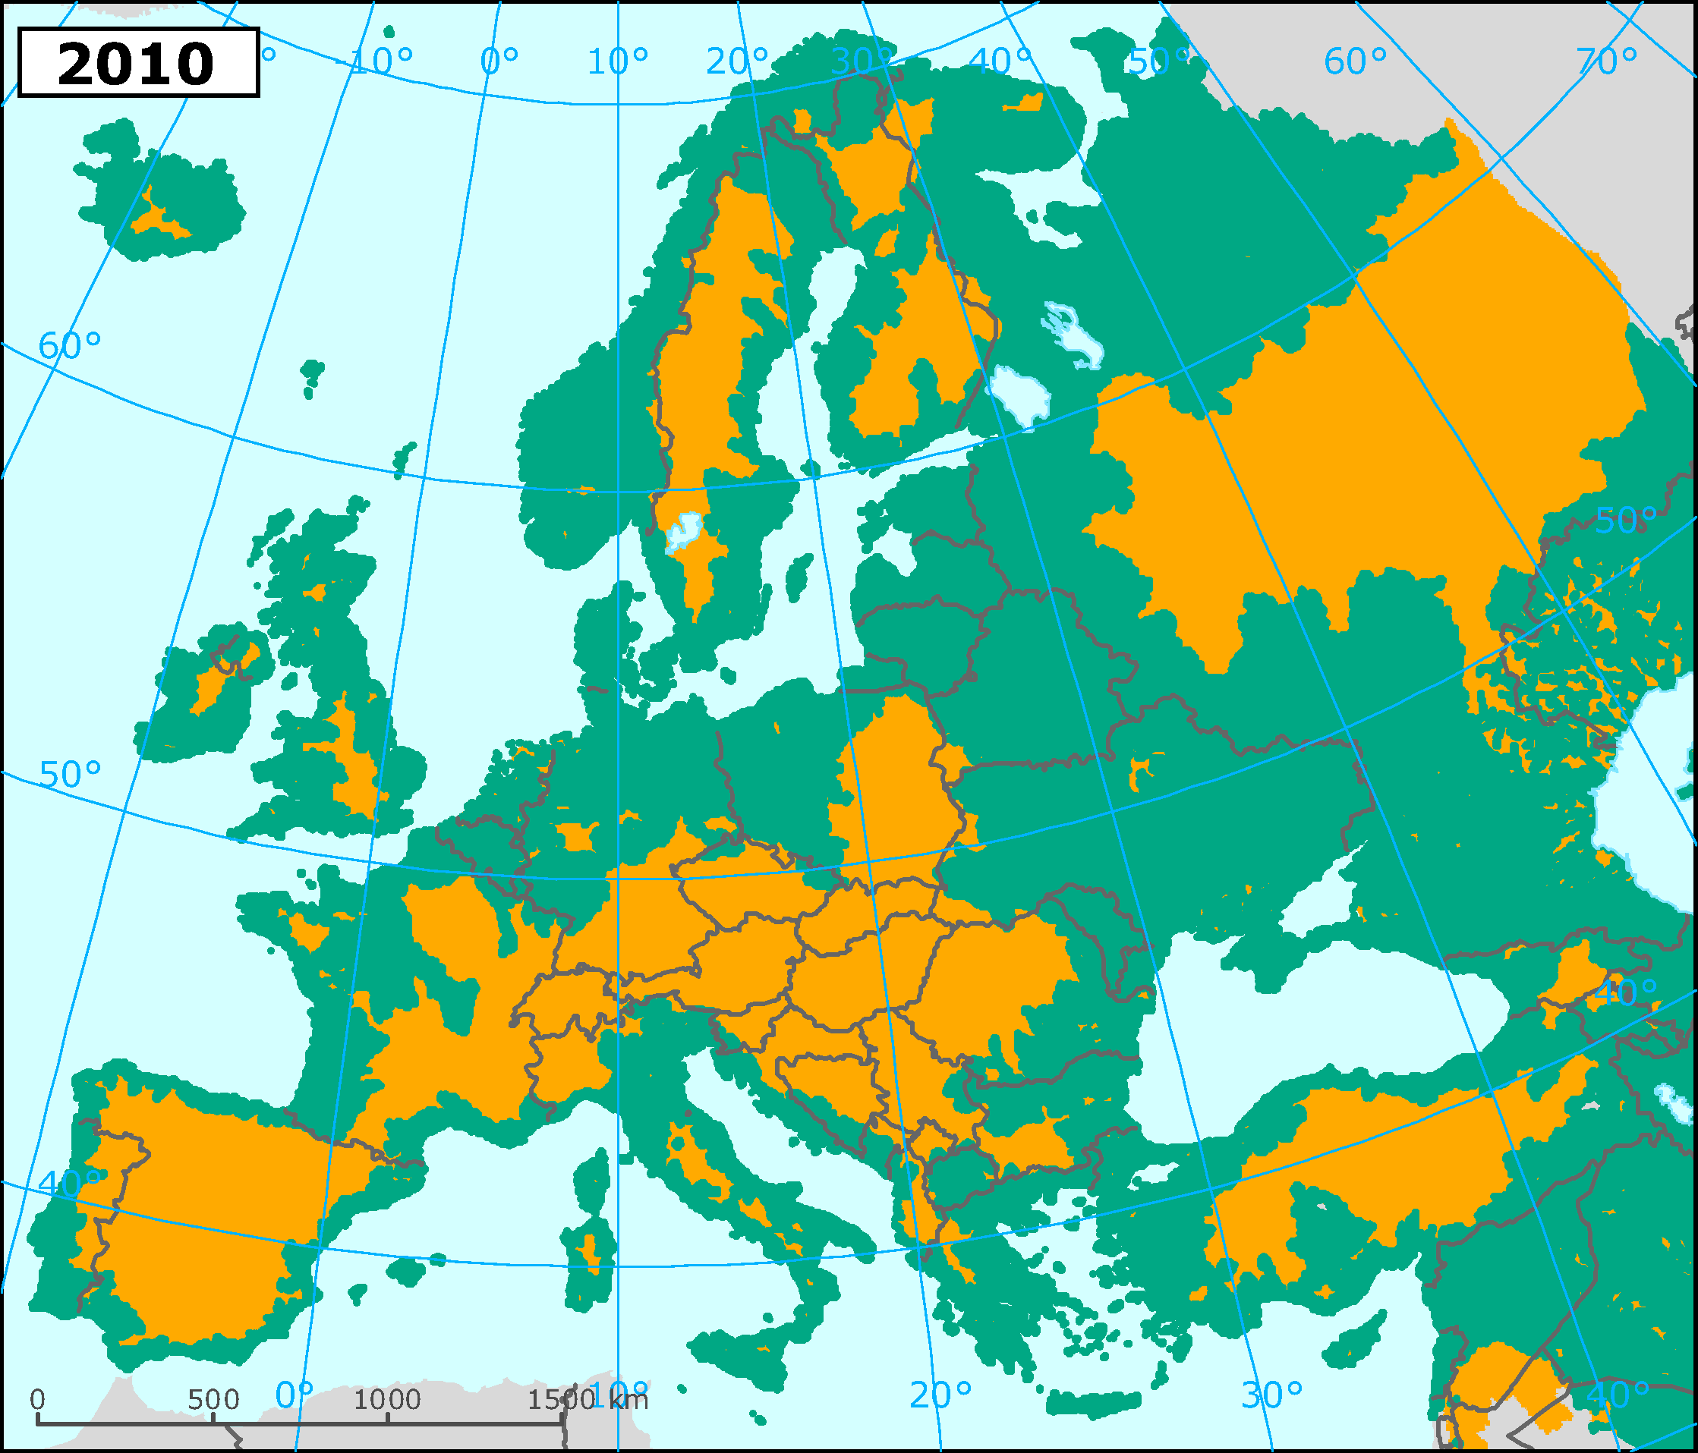
Barriers > 10 m
Globally, Europe is the continent with the smallest number of completely unfragmented Large River Systems - just three rivers in northwestern Russia
(Nilson, 2005)
Maps from European Environment Agency
Notes:
Over time we have considerably fragmented our rivers…1860

Slide 15
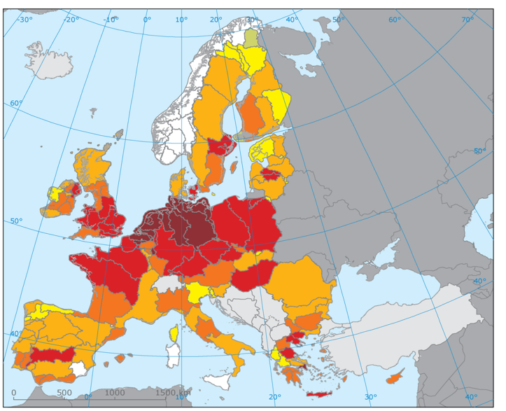
Only half the surface waters of Europe have met the Water Framework Directive target for 2015 of good ecological status
Most failures due to fragmentation
& habitat loss
Most failures due to fragmentation
& habitat loss
The times where we had rivers full of fish are almost over

Slide 16
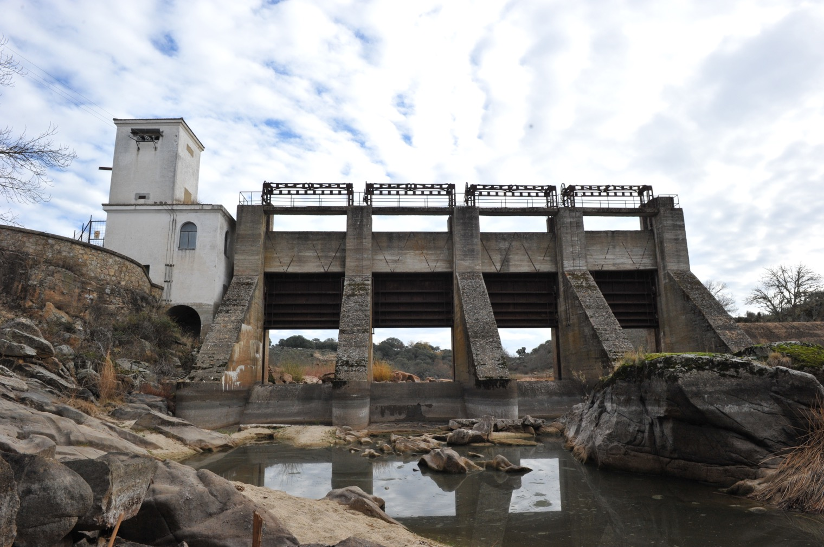
HOW MANY OBSTACLES ARE OUT THERE?
What can we do about it?
Notes:
And yet, these images are still incomplete! We do not yet fully understand the complete picture of the number of barriers within our rivers.

Slide 17
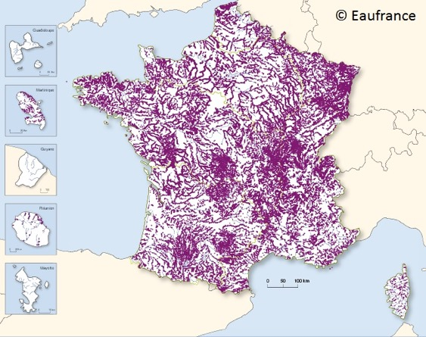
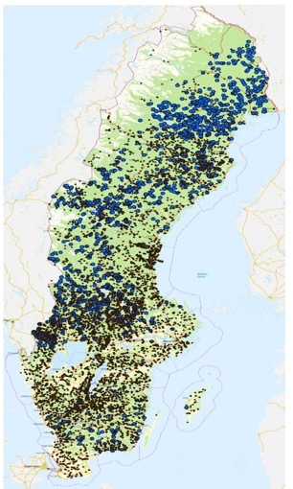
National databases
France: 83,795 man-made obstacles
UK: 22,000 man-made obstacles
SWEDEN: 9,298 barriers
Notes:
We do have national databases that provide some insight

Slide 18
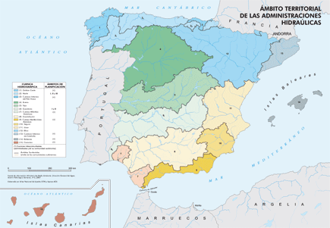
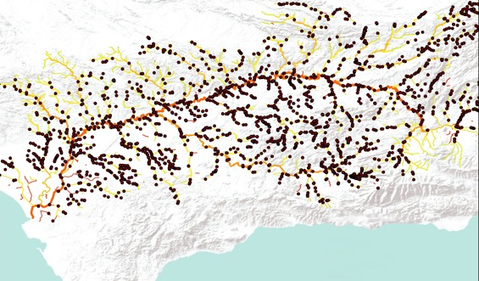
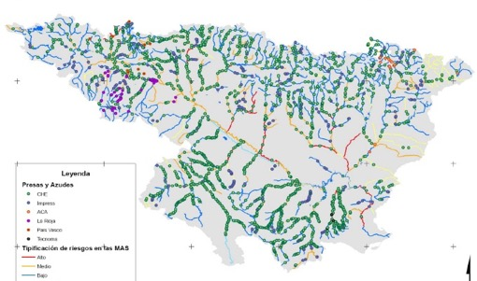
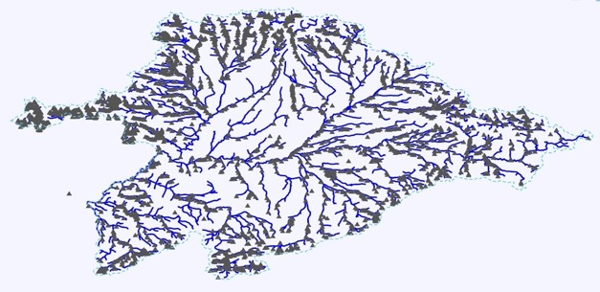
Regional databases
Guadalquivir Basin:2,236 barriers
(Source: Confederación Hidrográfica del Guadalquivir)
(Source: Instituto Geográfico Nacional)
Source: Kroes et al, 2015.
Ebro Basin:2,828 barriers
(Source: Confederación Hidrográfica del Ebro)
Duero Basin:3,746 barriers
(Source: Confederación Hidrográfica del Duero)
Source: Confederación Hidrográfica del Duero
Source: Tecnoma
Notes:
And regional data

Slide 19

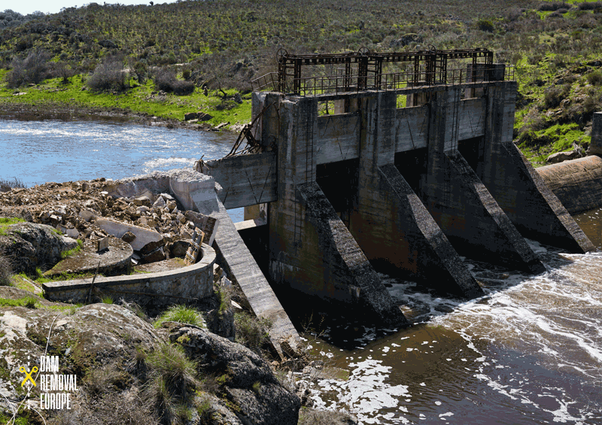
REMOVED BARRIERS
FRANCE: >2.400
SWEDEN: >1.600
FINLAND: >450
SPAIN: >200
UK: >130
NETHERLANDS: >50
ESTONIA: >5
SWITZERLAND: 1
BELGIUM: tbd
GERMANY: tbd
© Duero River Basin Authority
Notes:
And there have been thousand of barrier already removed thanks to initiatives like Dam Removal Europe!

Slide 20
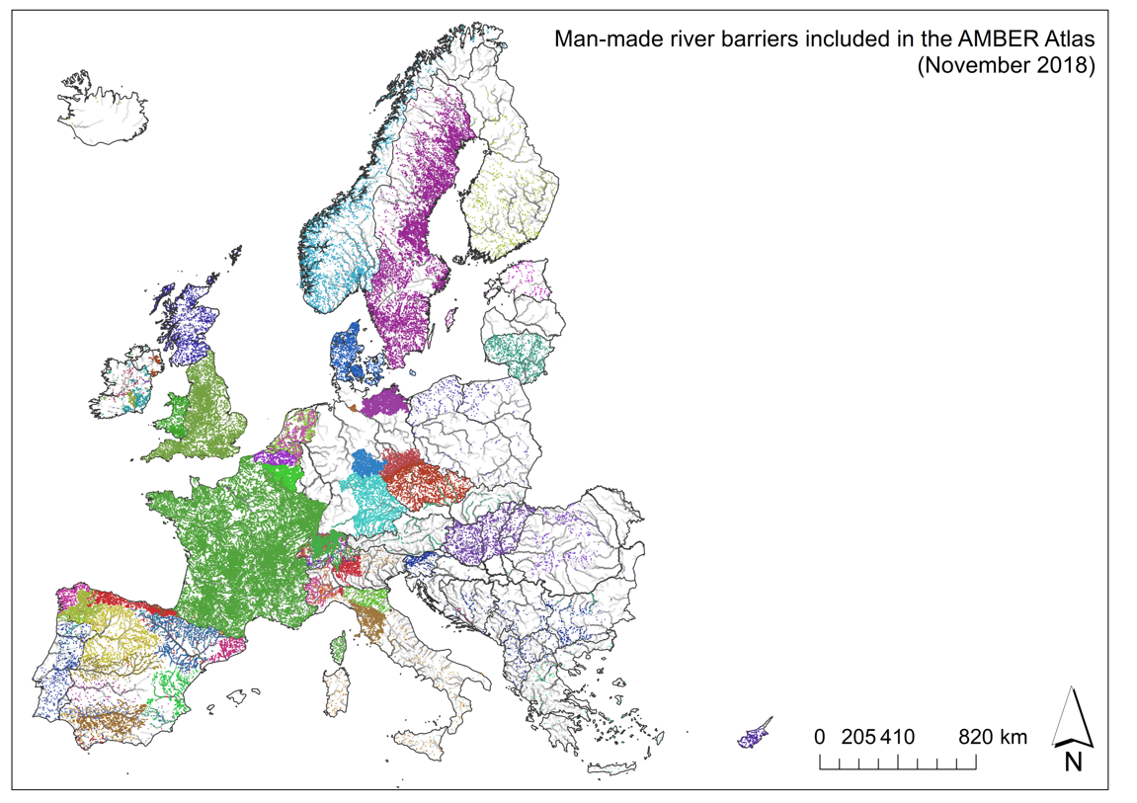


Some countries complete
Italy: only large dams
Eastern EU needs attention
Some are still in progress
First estimation:
> 1 million barriers
Notes:
But the fact remains that we don’t understand the full magnitude of the problem. And without knowing where these barriers are, we cannot properly manage or assess our rivers. Old and forgotten barriers are just as impactful as the big structures we see in the images shown. But big national databases and regional databases do not have this type of information because many times these barriers and structures are put into place by various people or companies without having to relay that information to anyone.

Slide 21
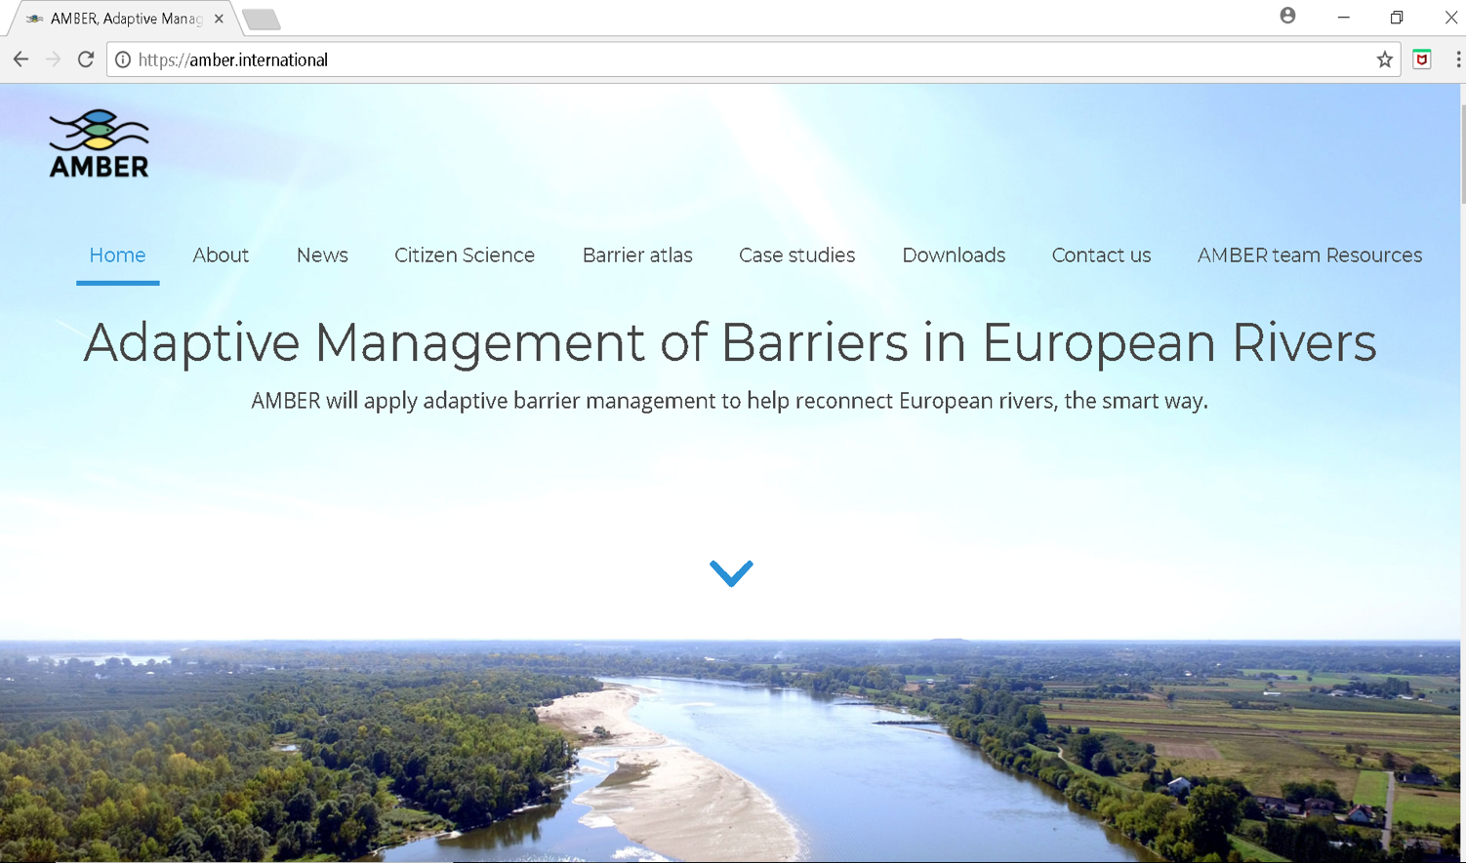
Notes:
And this is where we need the help of our citizen scientists. We would like to record those “missing barriers”

Slide 22
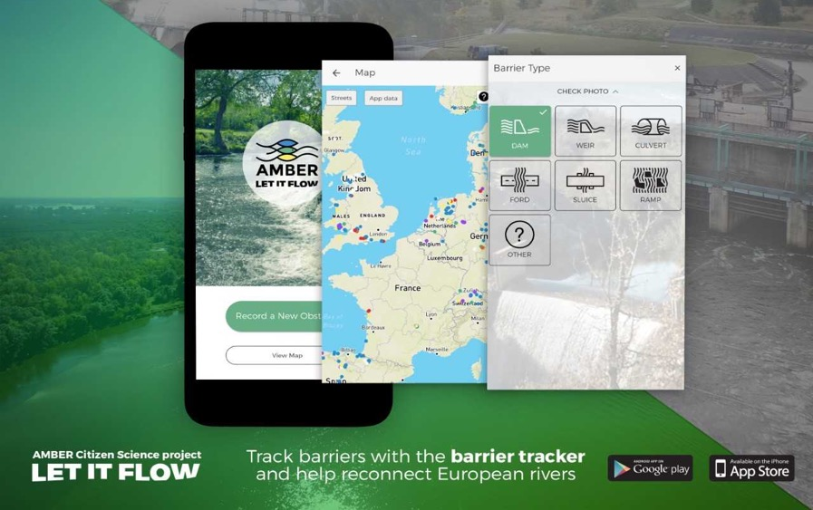
European Atlas of Stream Barriers making use of Citizen Science
https://www.youtube.com/watch?v=QjHJwy2wODM&t=12s
Notes:
For the AMBER project, it is imposible to collect all the existing barriersin all the rivers in all the European acountries, and therefore, the citizens contribution is crucial. This application is already translated into 9 languages, and can be downloaded from Play store & app store for both Android and Apple, respectively. If you would like it to be translated into your own language, please do not hesitate to contact AMBER.

Slide 23
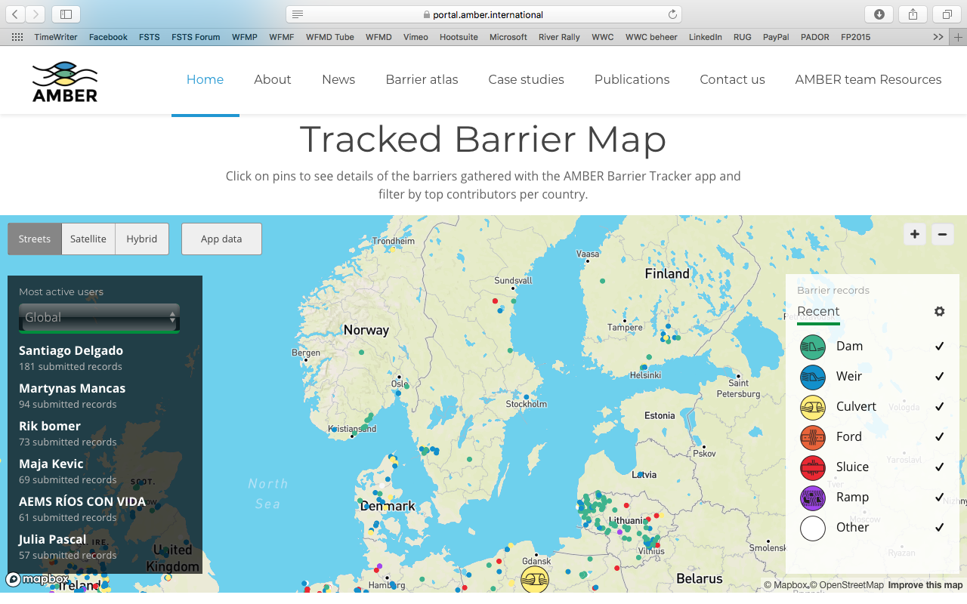
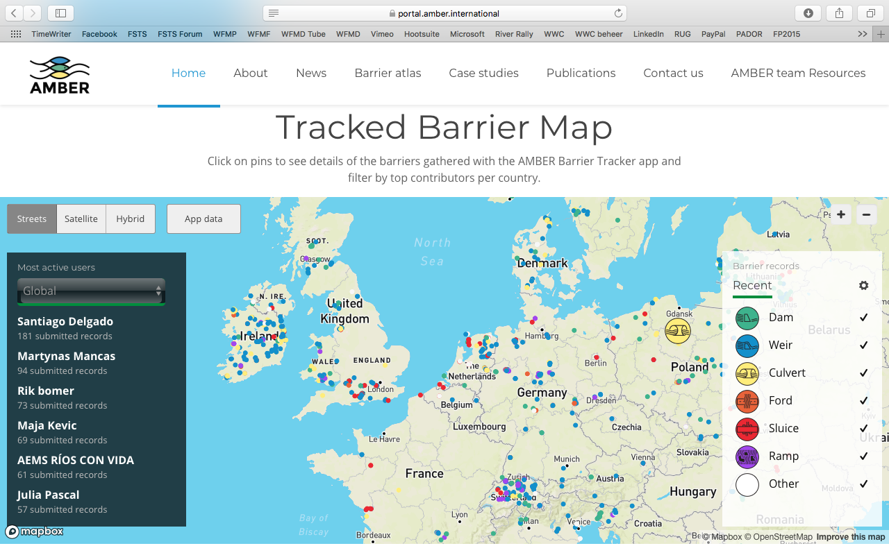
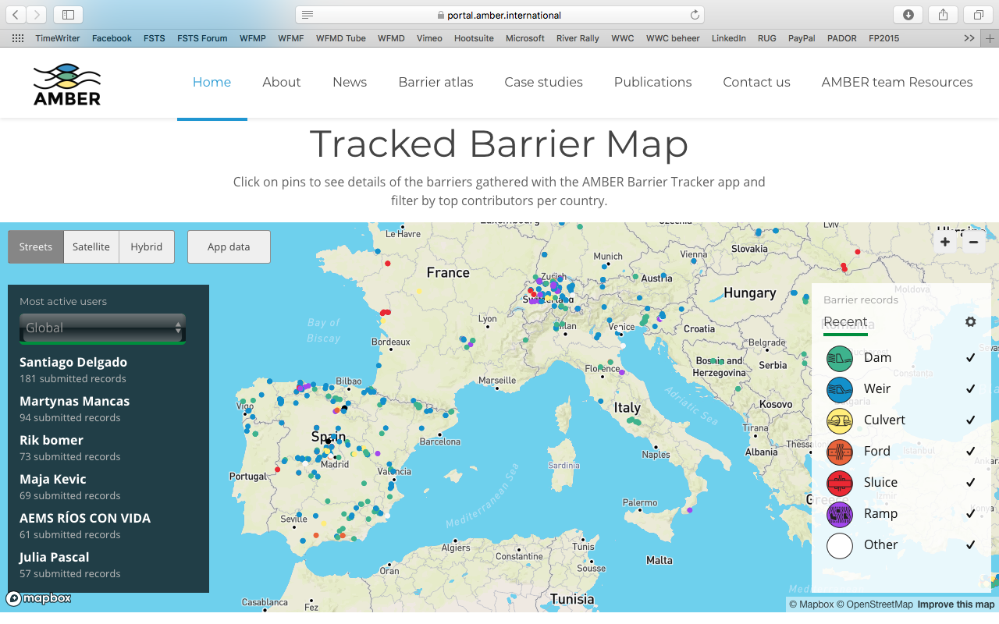
8000 BARRIERS
573 USERS
Notes:
So far we have tracked some barriers across Europe! And some of our users are responsible for over 100 barriers tracked!

Slide 24
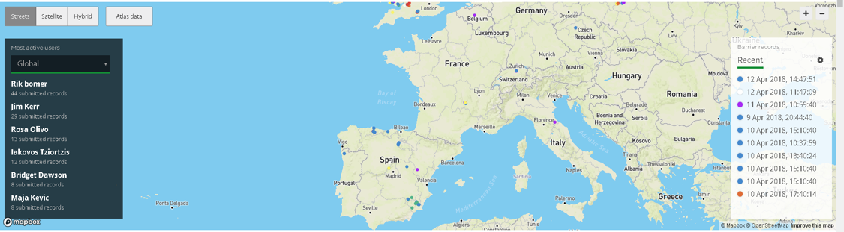
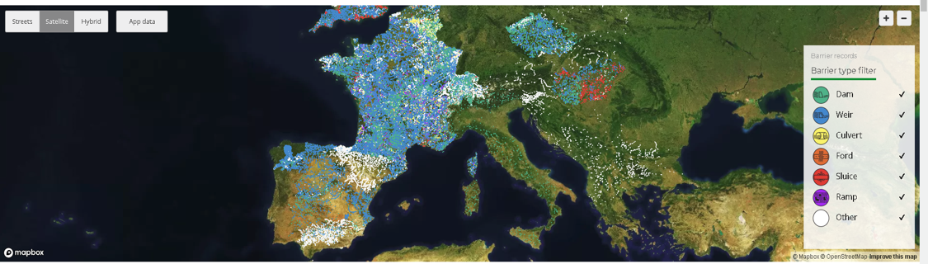
European Atlas of Stream Barriers making use of Citizen Science
www.amber.international
Notes:
A first and preliminary version of the Atlas can be displayed in the AMBER website (Citizen Science Tab) were you can see both the data recorded by citizens using the Barrier Tracker and also the institutional data. The data gathered by the app can help complete the missing data gap and provide an extra layer for environmental managers to understand the magnitude of the problem in their rivers. And by knowing where the barriers are, they can then work to remove the old ones, enhance the important ones and more efficiently manage our rivers!

Slide 25
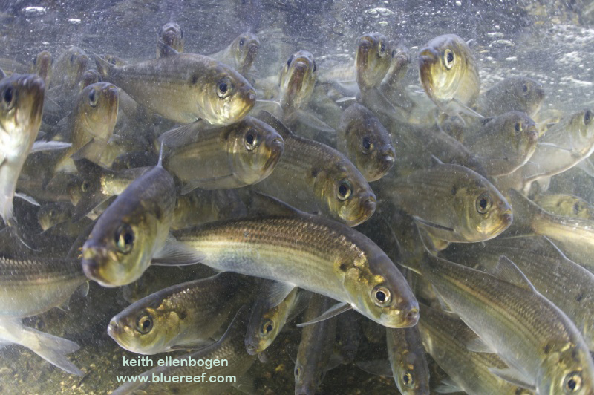
If we want our rivers full of fish it will mean that we should protect and restore the energy input and nutrient flows.
Notes:
Please help us in doing this! There is no way that we can cover all of Europe ourselves.

Slide 26
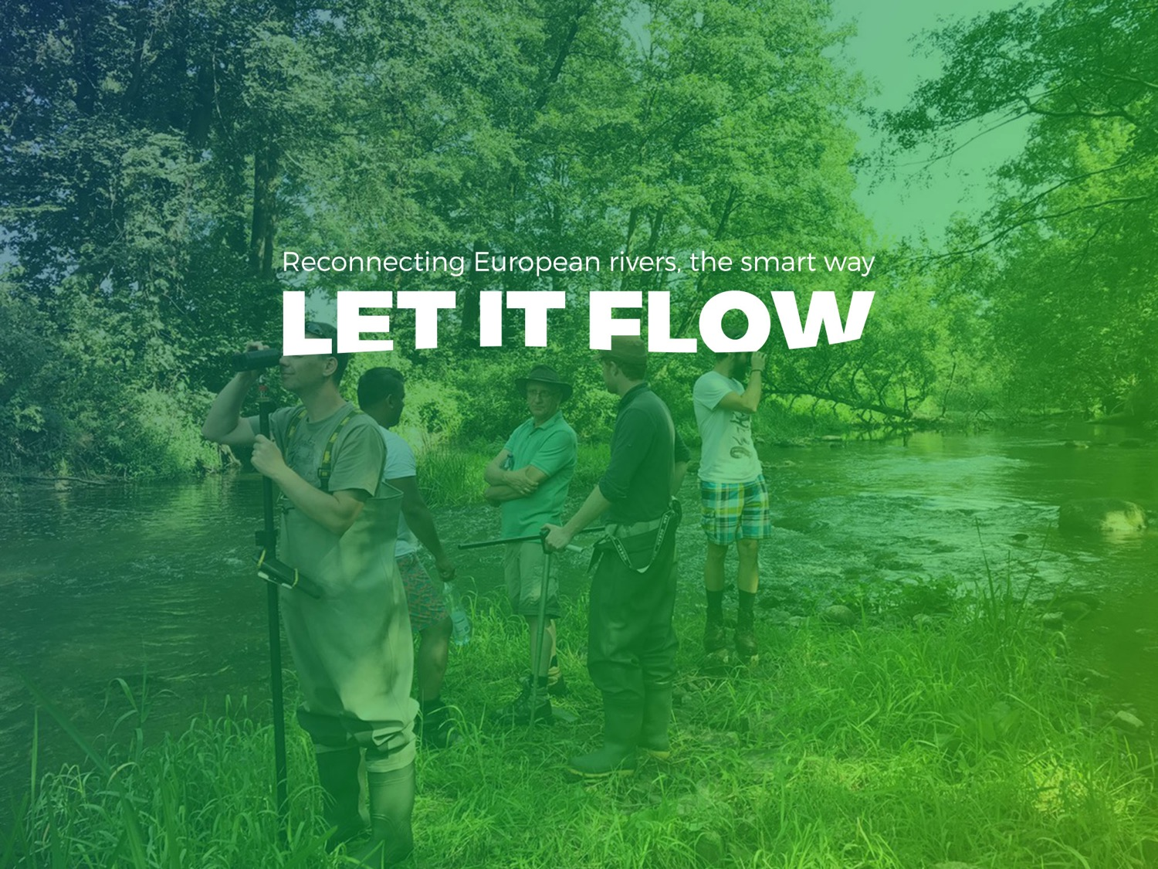
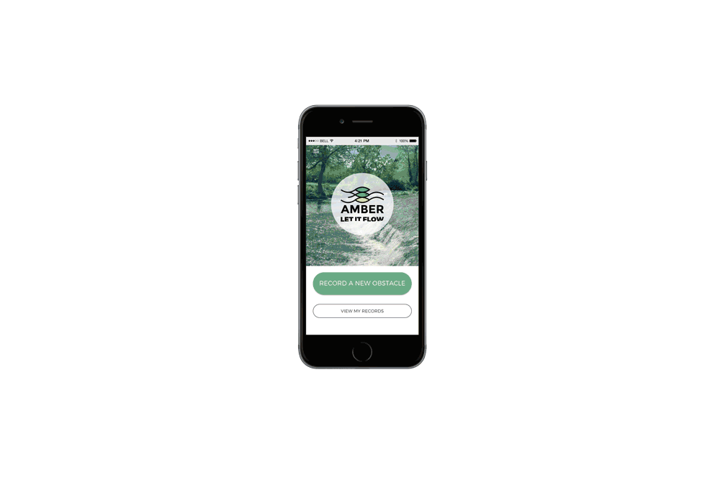


BARRIER TRACKER
11 LANGUAGES

Slide 27





How to follow us
http://www.amber.international
https://www.facebook.com/AMBERtools
https://twitter.com/ambertools
@AMBERtools

